Slide 1

Rachel Blumenstein, Kevin (Whijae) Chyun, Josh Gindi, Tianyu Zhou

Slide 2
Investment Thesis
Given a high valuation range using DCF and comparable analysis, we see OWL as well-positioned to disproportionately benefit from Credit, GP Stakes, and Net Lease secular trends, as well as retail penetration, differentiated products, and fund maturation
Credit: OWL will benefit disproportionately from the expansion of private credit given its heavier gearing than peers
GP Stakes: Despite mature asset class, growth will stabilize and continue as Blue Owl grows
Net lease: Scalable and differentiated product that has been undervalued
Valuation: Undemanding for a company that should grow FRE by +25-30% through ‘25E
1
2
3
4

Slide 3
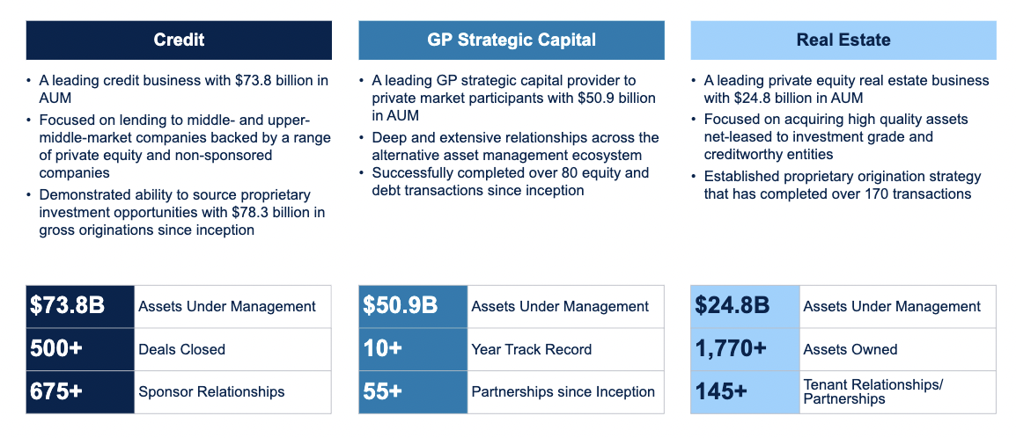
Company Overview (1/2)
Business Overview

Slide 4
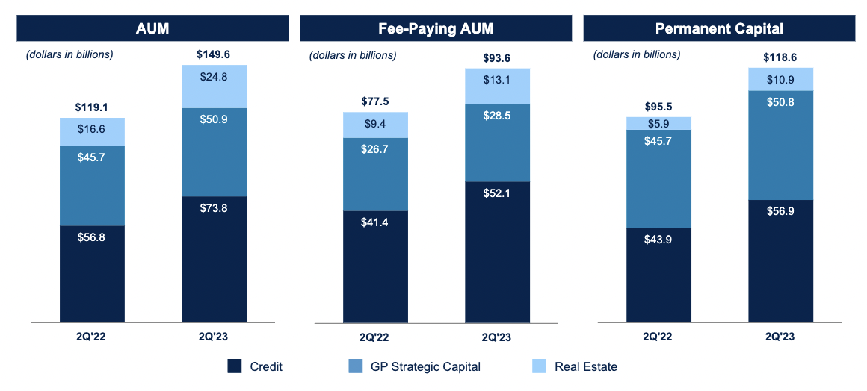

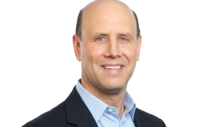
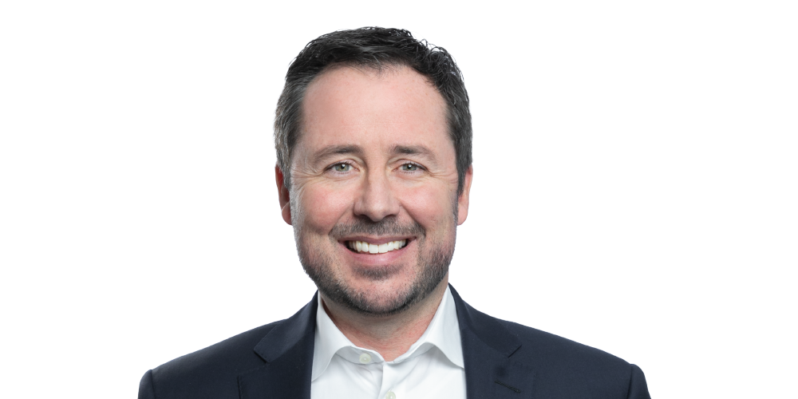

Company Overview (2/2)
Executive Leadership
Assets Under Management
Doug Ostrover
Co-Founder and Co-CEO
Michael Rees
Co-President
Marc Lipschultz
Co-CEO
Craig W. Packer
Co-President

Slide 5
Industry Landscape
Direct Lending
With ~63% of surveyed LPs indicating that they intend to increase allocation to private credit, OWL is poised to benefit disproportionately. Despite increased competition in direct lending, with ~4 new entrants in to the non-traded BDC market in 2022, we think the banks will cede ~$450-550bn in credit to the private markets, suggesting ample white space for OWL to deploy capital, in addition to incremental deployment from an eventual recovery in the M&A environment.
GP Strategic Capital
OWL is currently building out a GP led secondaries business, which we see as a highly attractive growth avenue. We have already seen several secondaries funds close this year at an average step-up of ~1.8x. Furthermore, GP led secondaries volumes have grown at an annual pace of +27% since 2013, suggesting increased demand for capital within the space.
Real Estate Products
While Real Estate is generally out of favor within institutional LPs, we see a compelling opportunity for OWL to further penetrate the Retail ecosystem via the firm’s non-traded REIT. Having already established a retail presence with the firm’s non-traded BDCs on several Wirehouse platforms, we see an emerging opportunity as advisors try to diversify away from existing non-traded REIT products.

Slide 6
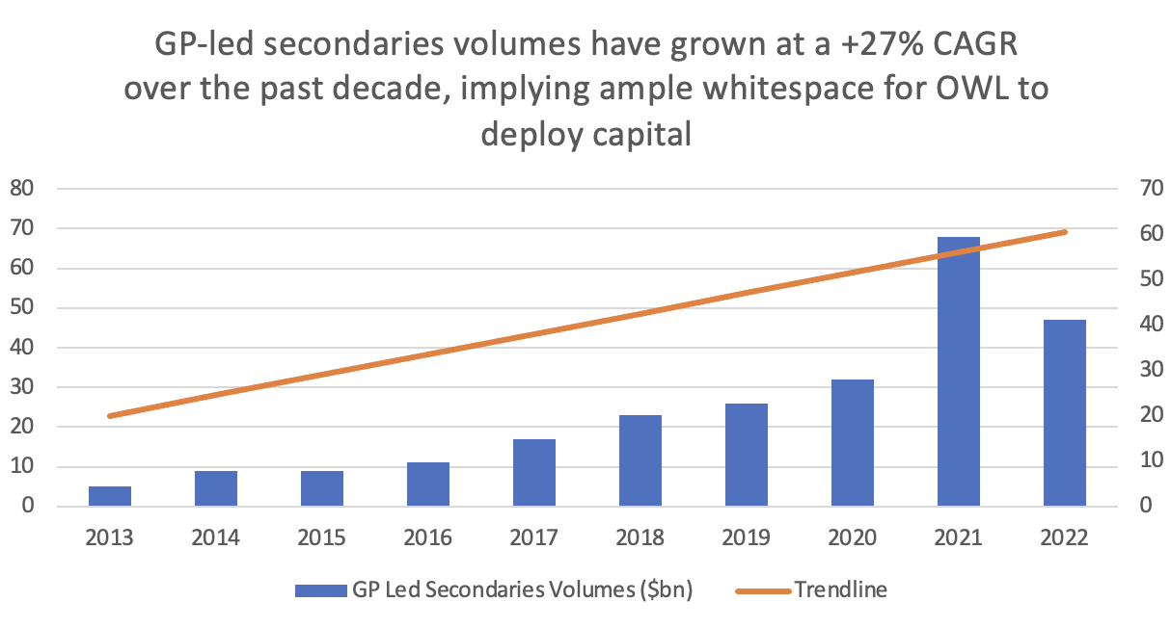
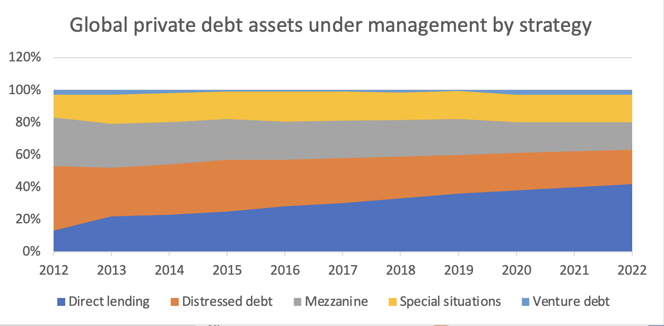
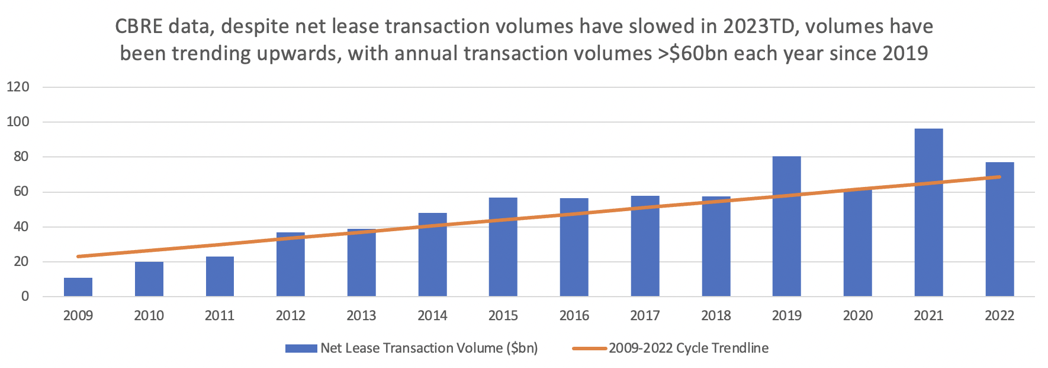
Industry Growth Rate

Slide 7
AUM Income Model
$ in millions | 2023E | 2024E | 2025E | 2026E | 2027E
Direct Lending FEAUM | $62,728 | $80,474 | $101,871 | $127,949 | $160,872
% Growth | 28.02% | 28.29% | 26.59% | 25.60% | 25.73%
Mgmt Fees | $813 | $1,136 | $1,562 | $1,995 | $2,545
% of FEAUM | 1.30% | 1.41% | 1.53% | 1.56% | 1.58%
GP Capital Solutions FEAUM | $37,295 | $47,349 | $59,194 | $72,858 | $88,270
% Growth | 29.95% | 26.96% | 25.02% | 23.08% | 21.15%
Mgmt Fees | $730 | $927 | $1,159 | $1,426 | $1,728
% of FEAUM | 1.96% | 1.96% | 1.96% | 1.96% | 1.96%
Real Estate FEAUM | $14,520 | $18,876 | $24,161 | $30,926 | $39,586
% Growth | 32.00% | 30.00% | 28.00% | 28.00% | 28.00%
Mgmt Fees | $120 | $175 | $249 | $318 | $407
% of FEAUM | 0.83% | 0.93% | 1.03% | 1.03% | 1.03%
Total Revenues (mm) | $1,926 | $2,599 | $3,457 | $4,359 | $5,464
Compensation Expenses | $1,059 | $1,300 | $1,556 | $1,961 | $2,459
% of Revenue | 55.0% | 50.0% | 45.0% | 45.0% | 45.0%
Amortization of Intangibles | $307 | $208 | $173 | $218 | $273
% of Revenue | 12.0% | 8.0% | 5.0% | 5.0% | 5.0%
SG&A | $270 | $338 | $449 | $567 | $710
% of Revenue | 14.0% | 13.0% | 13.0% | 13.0% | 13.0%
Total Expenses | $1,636 | $1,846 | $2,178 | $2,746 | $3,443
Operating Income | $290 | $754 | $1,279 | $1,613 | $2,022
1
2
3
4
Note: (1), (2), (3) Fee-Earning AUM growth projected using historical CAGR, sector-specific trends, macroeconomic trends, comparable analysis, and Blue Owl portfolio composition
(4) % mgmt fees, compensation, amortization and SG&A using the long-term average fee rate of comparable companies and historical rate of fund maturation

Slide 8
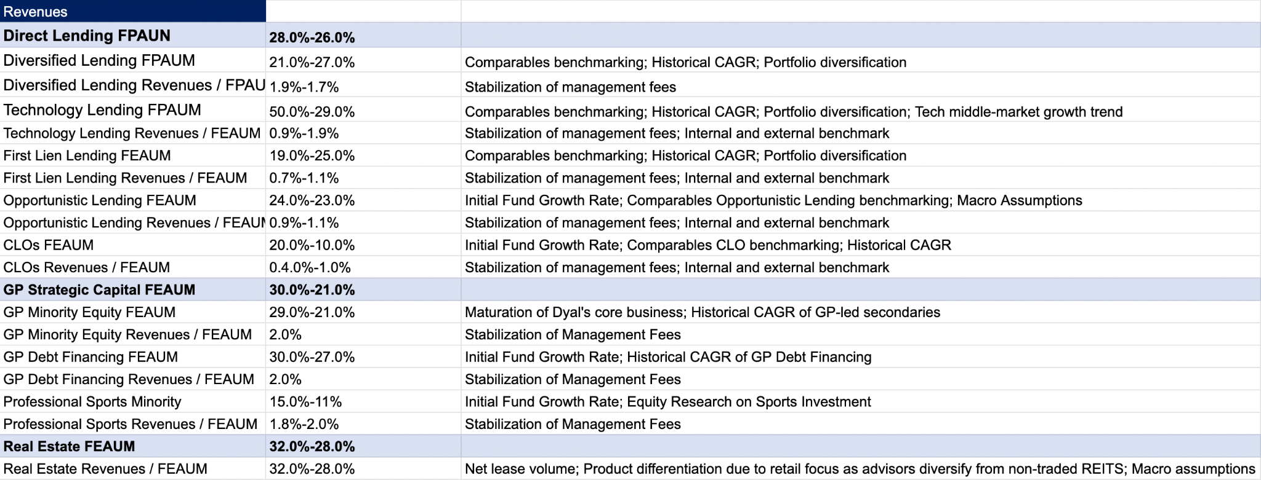
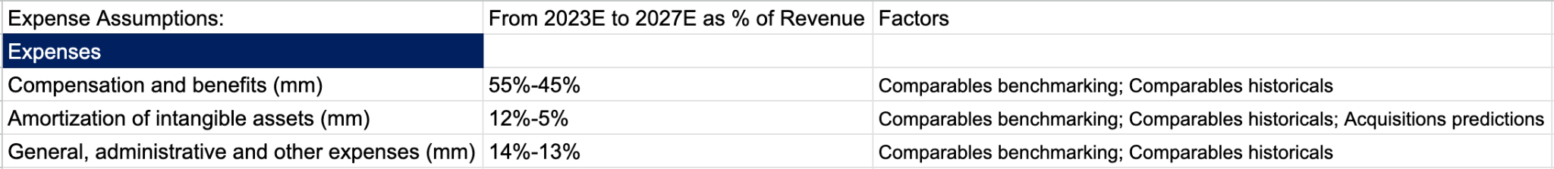
Operating Assumptions

Slide 9
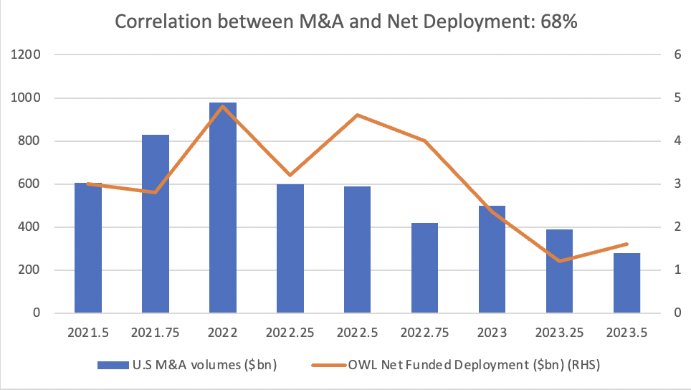
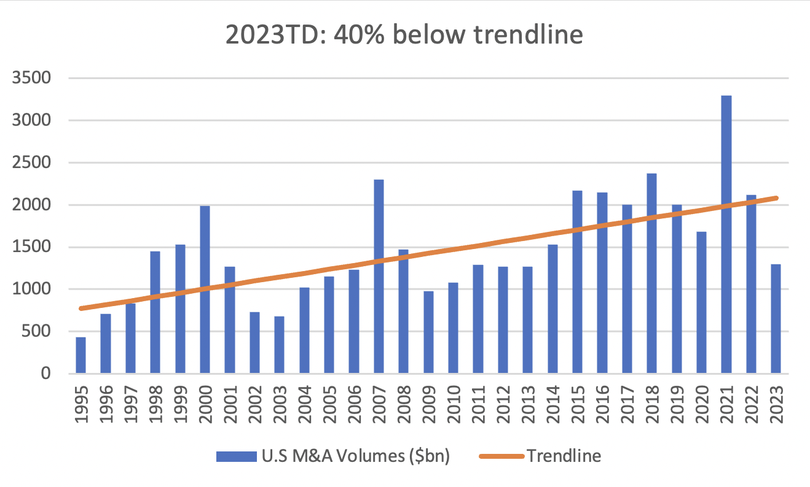
Revenue Assumptions
Recovery in M&A volumes as a catalyst for DL deployment which would be an overall positive for OWL, even if the firm cedes share to new entrants
Global M&A revenues are currently running ~40% below trend, but should inflect beginning in 2024. This is reflected prominently as an upward adjustment in products of direct lending.
1
2

Slide 10
Weighted Average Cost of Capital
Cost of Equity |  | Cost of Debt
Levered Beta | 1.21 | Cost of Debt | 3.43%
Risk Free Rate | 5.20% | Effective Tax Rate | 18.90%
Equity Risk Premium | 5.50%
Cost of Debt | 11.86% | After Tax Cost of Debt | 3%
Equity / Market Cap | 90.67% | Debt / Market Cap | 9.33%
WACC | 11.01%
Assumptions
Risk free-rate taken as the 10-year treasury yield
Equity risk premium given by Kroll estimate
Beta re-levered according to current capital structure
Assumes a maintained capital structure
Cost of debt estimated using the capital asset pricing model

Slide 11
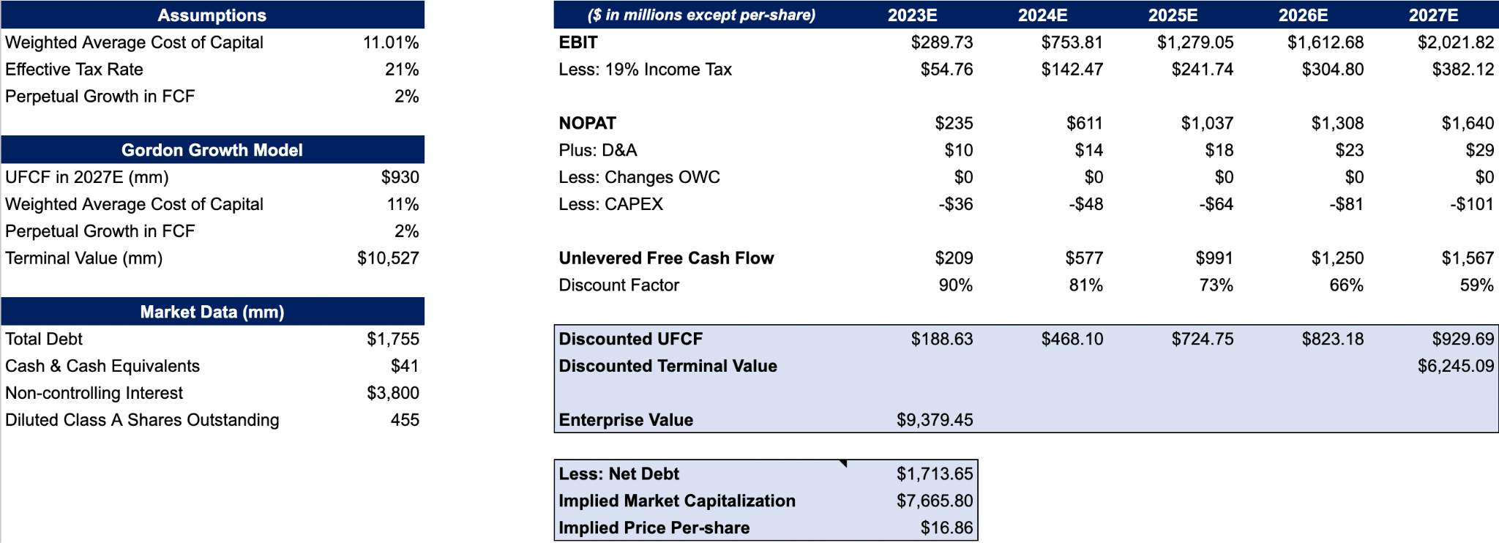
DCF Analysis

Slide 12
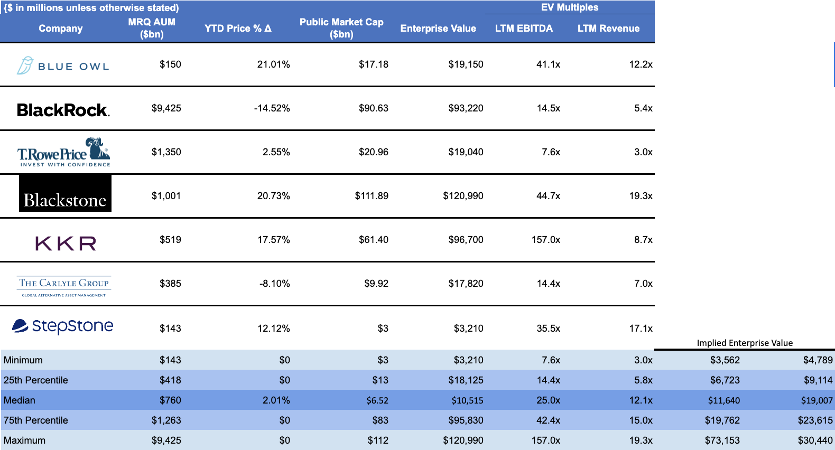
Public Comparable Analysis
Implied Price Per-share Range
$11.0 - $39.6
1
Implied Price Per-share Range
$16.2 - $48.1
2
Note: (1) Found using multiples of 25th - 75th percentile EV / EBITDA multiples of public comparables; (2) Found using 25th - 75th percentile EV / Revenue multiples of comparable companies.

Slide 13
Further Considerations
Reduced fundraising drives weaker than expected FRE growth
Poor performance in a credit downturn may impair earnings and BDC’s ability for future fundraising
Management fee can drastically decline if BDC competition puts pressure on fee rates
Net lease strategy falls short of expectation due to macro conditions
Class A share conversions and limited share liquidity decrease share performance
1
2
3
4
5

